Slide 1
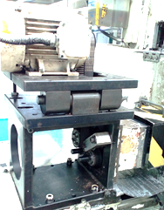
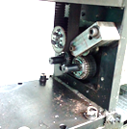
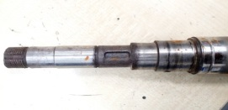
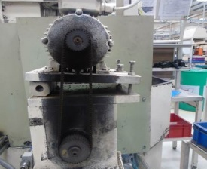
P15
TPM CIRCLE NO :- 02
ACTIVITY
KK
QM
PM
JH
SHE
OT
DM
E&T
KAIZEN IDEA SHEET
TPM CIRCLE NAME:
LOSS NO. / STEP
DEPT :-
RESULT AREA
P
Q
A
C
D
S
M
CELL:-
CELL NAME:- Bracket SPM
MACHINE / STAGE :- A247 Bracket
OPERATION :- Drilling 4.2mm
KAIZEN THEME :To eliminate bracket SPM A1 machine breakdown
IDEA : No metal to metal contact
Problem present status :- 4.2 mm drill spindle frequent breakdown. 4 B/d / month and Apprx 250 minutes / month
COUNTERMEASURE:-
Replacing gear drive & key mechanism with modified Shaft & Taper locking pulley
BENCHMARK
245 min/ month
TARGET
0
KAIZEN START
05.05.2016
KAIZEN FINISH
10.06.2016
TEAM MEMBERS :
Prakash Harihar
Sujit Zirpe
Worn out key
BENEFITS :-
MTBF increased from 7.5 Days to
life time (PM planned @ 1 Year)
2) Production per month increased by1050
Worn out key way
Taper locking pulley
Modified shaft and tapered locking pulley mechanism
KAIZEN SUSTENANCE
Before
After
WHY - WHY ANALYSIS :-
RESULT :-
WHAT TO DO:-. Bearing replacement.
HOW TO DO:- During PM
FREQUENCY :- @ 12 months
Why 1 – 4.2 mm Drill spindle breakdown Why 2 – Spindle jammed Why 3 – Play in transmission gear Why 4 – Key between shaft& gear wear and tear. Why 5 – Forced deterioration due to metal contact.
ROOT CAUSE : Metal to Metal contact
REGISTRATION NO. & DATE :
REGISTERED BY :- Prakash & Sujit
Drill spindle b/d phenomena eliminated
Availability of machine increased by
245 min / month
MANAGER’S SIGN :- SNC

